Slide 1
Separating Cyclostationary Signals using the Nonlinear Dynamics of Continuous-Time Recurrent Neural Networks
Research progress 1/12/2018
Vincent Baker
Physics Department
Drexel University

Slide 2
Motivation
Current machine learning paradigms don’t resemble the brain
Reservoir computing methods, especially Liquid State Machines, provide a biologically plausible computational framework
This work will investigate the liquid state machine framework with an emphasis on the nonlinear delay dynamics that arise from realistic distributions of synapse lengths and signal propagation times
The work will focus on recognizing stationary and cyclostationary time series signals

Slide 3
Novel contributions
This research will explore the effect of realistic distance-based synaptic propagation times on the computational power of a columnar neural circuit
This research will explore the contribution of spatial organization and disorganization to neural dynamics
This research will examine the ability of neural circuits to separate cyclostationary time series signals

Slide 4
Current status
Completed a literature review of liquid state machines and synaptic dynamics
Implemented Izhekevich neural dynamics, first order synapse dynamics, and variable synaptic propagation times in MATLAB
Constructed columnar neural microcircuits with distance-dependent connectivity and synaptic delay
Demonstrated separation property of this neural circuit

Slide 5
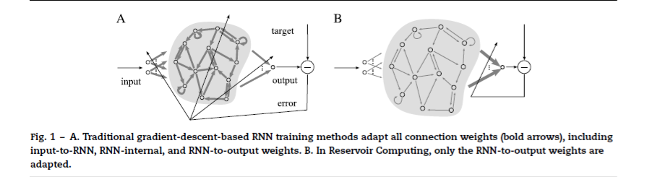
Reservoir Computing
Nonlinear reservoir with fading memory is driven by an input
The input evokes complex dynamics in the reservoir
A linear readout map extracts the desired data from the reservoir
Multiple readouts can be trained with simple regression to extract different information from the same untrained reservoir
Lukosevicius and Jaeger 2009

Slide 6
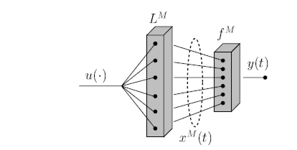
Liquid State Machines
The reservoir can be viewed as a nonlinear filter L^{M} that transforms an input u into an M-dimensional state vector x^{M}
Multiple readout functions f^{M} then map the state vector onto the desired output(s) y
Readout functions are trained independently, reservoir is not trained
LSM has demonstrated excellent performance in word recognition (Zhang et al 2015)
“Real-Time Computing Without Stable States: A New Framework for Neural Computation Based on Perturbations”, W. Maas, T. Natschlager, H. Markram

Slide 7
Liquid state machine reservoirs
Neural circuits have been used extensively as LSM reservoirs
Common topology is a column on a unit grid, initial work used a 3x3x15 column of 135 LIF neurons
Neuron connectivity is distance-based, biologically plausible connectivity has been shown to provide the best reservoir dynamics
Propagation times have NOT been modeled realistically, typically the propagation time down all synapses are identical regardless of neuron positions

Slide 8
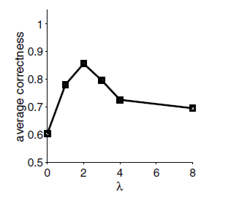
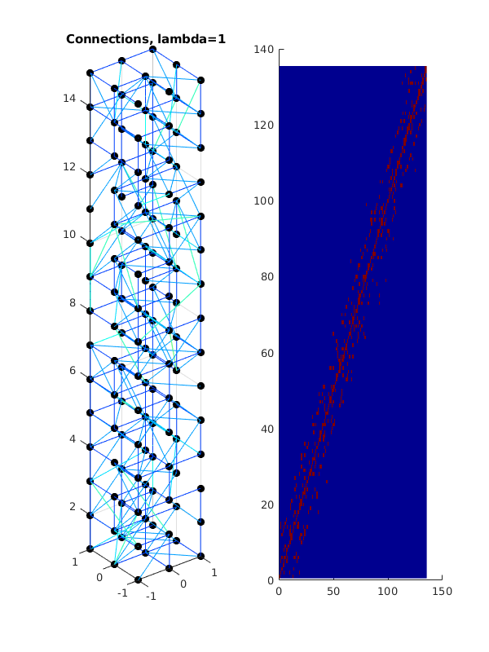
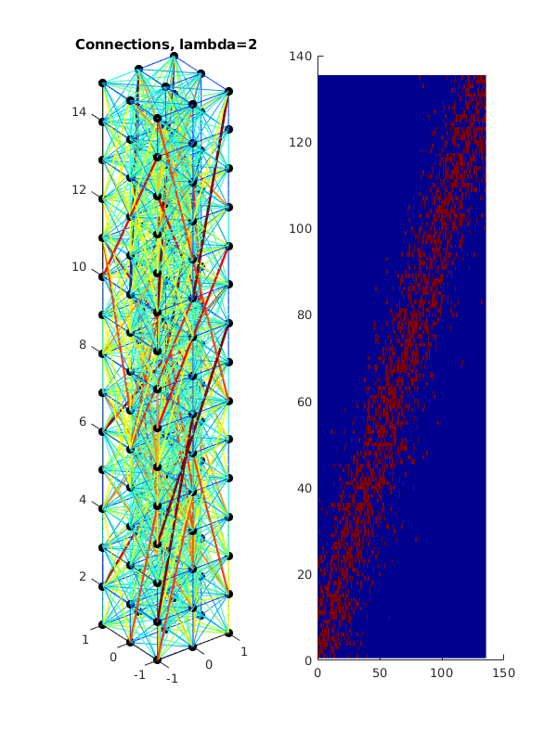
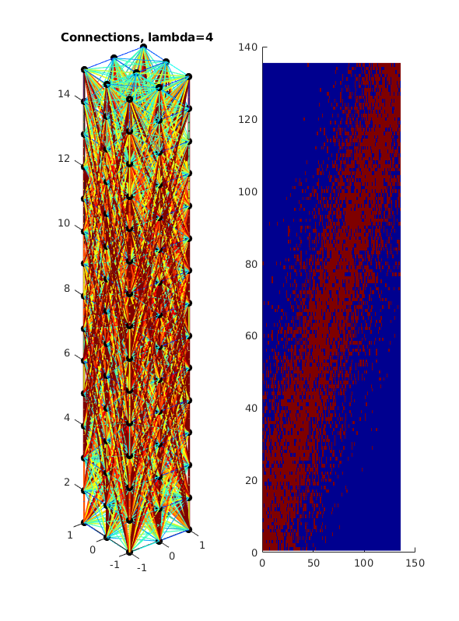
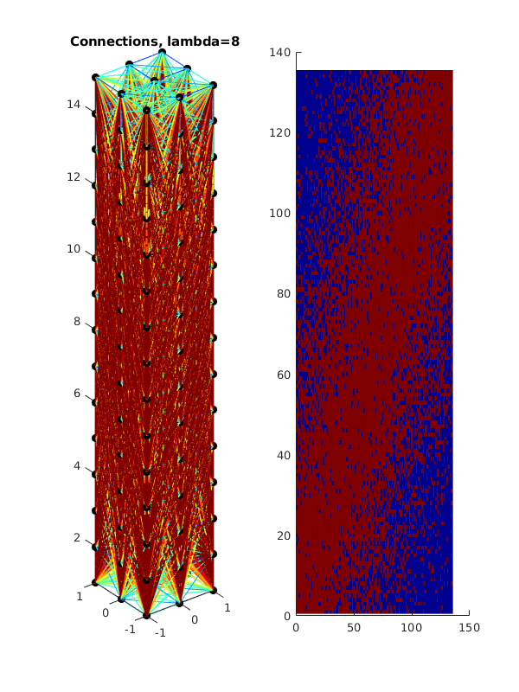
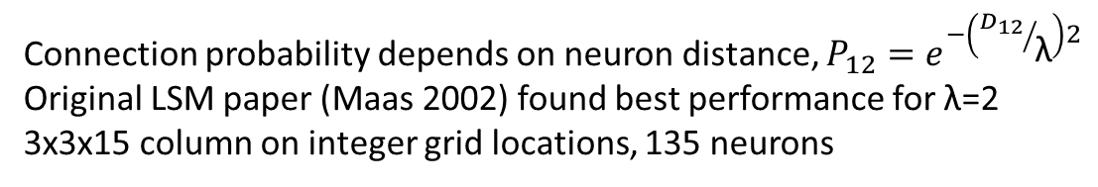
Neural connectivity
Connection probability depends on neuron distance, $P_{12}=e^{−\left({D_{12}}/{\text{λ}}\right)2}$
Original LSM paper (Maas 2002) found best performance for λ=2
3x3x15 column on integer grid locations, 135 neurons

Slide 9
Fidelity of neural models
Simplified computational models
High-fidelity biological models
Increasing dynamic fidelity, increasing computational requirements
Perceptron:
Weighted sum of input values
No dynamic behavior
Not spiking
I-F:
Simple decay
Basic spiking mechanism
Izhikevich:
Two coupled differential equations
Four parameters
Replicates observed spiking patterns
Hodgkins-Huxley:
Four coupled differential equations
>10 parameters
Corresponds to known ion channels
This work lives here, numerical integration in MATLAB and NEURON

Slide 10
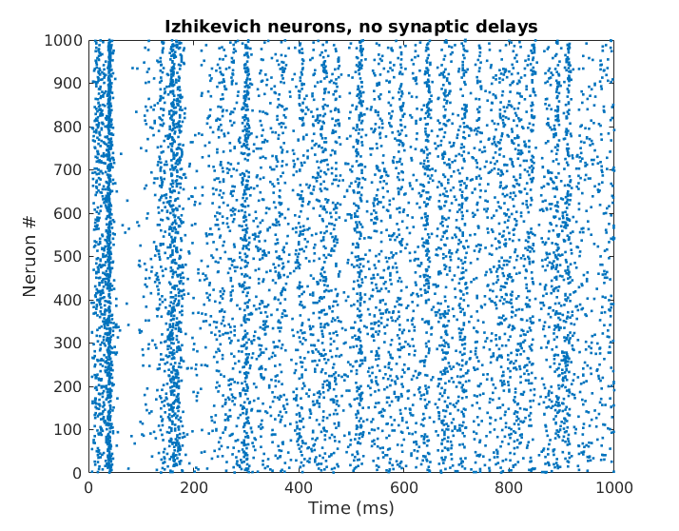
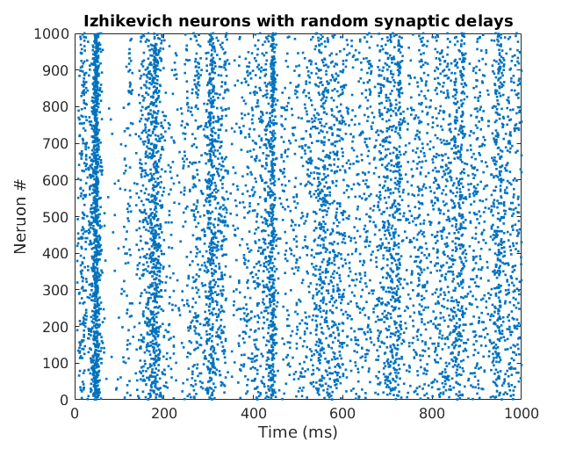
Neural dynamics
Created a neural simulation using the Izhikevich model for neural dynamics, added synaptic delays.
Validated synaptic delay implementation against Izhikevich ‘03 code, using the same parameters and inputs we see similar behavior.
Classic Izhikevich (2003)
With random synaptic delays 0-4 ms

Slide 11
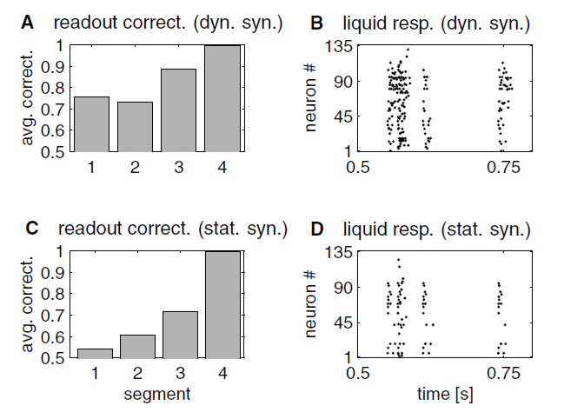
Synapse dynamics
Maas et al showed that dynamic synpases provide longer fading memory
Implemented first-order synapse dynamics
Synaptic delays based on inter-neuron distances (novel work)
Maas2002 demonstrated that dynamic synapses (top) provided better classification on a four-element characterization problem compared to static synapses (bottom)

Slide 12
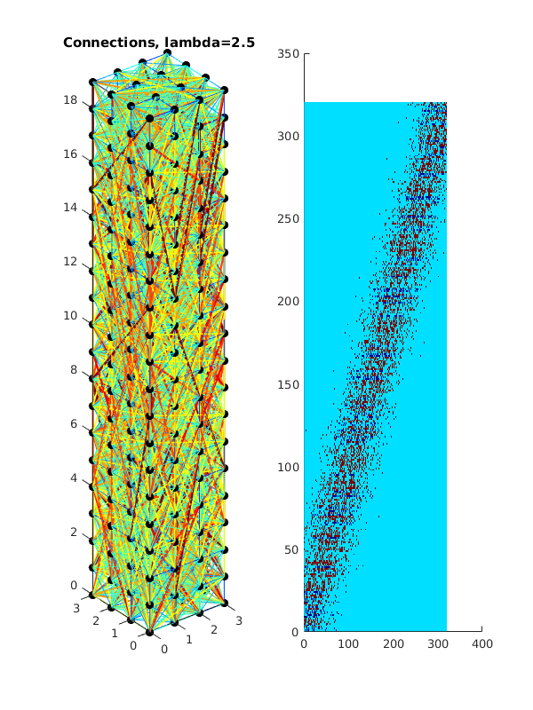
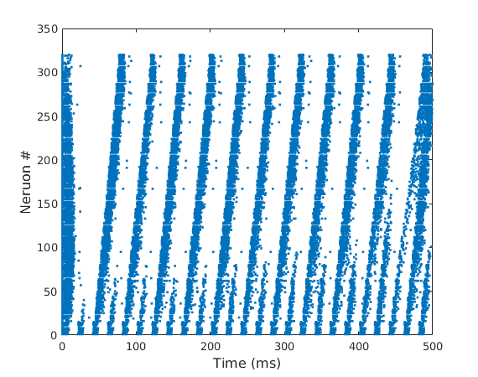
Response to stationary signals
A stationary signal (sine wave, frequency 50 Hz) was injected into column
Frequency conversion observed as signal propagates to top layer, indicates potential to separate stationary signals of different frequencies
Modulated pattern observed at top layer, output frequency is not 50 Hz
50 Hz sine input injected into bottom layer of column

